Slide 1

Grocery Delivery Application
Guided by: Team Members:
A. Varadharajan C. Priyadharshini (EBEON1222705676)
S. Kaviya (EBEON1222714256)
S. Aarthy (EBEON1222708290
T. Ranjithapriya (EBEON1222722728)
Supporter & Sponsor,
Edubridge India P L & Capgemini

Slide 2
ABSTRACT
An online Grocery store permits a customer to submit online orders for items and/or services from a store that serves online customers. The online store system provides an online display of all the items they want to sell.
This web based application helps customers to choose their daily needs and products to their shopping cart. Customers provide their complete detail of address and contact and they get their chosen products in their home.

Slide 3
Technologies
Spring boot
Maven
Java8
My SQL
Hibernate
Angular
Html
CSS
Java script
Typescript

Slide 4
LIST OF MODULES
Registration and Login
Home Page
Product Category
Order and Payment History
Chat Bot
Cart Process
Payment process
SMS Sending
GPS Tracking

Slide 5
MODULES DESCRIPTION
Module 1: Product Category
Product Catalog Building is a simple solution for creating online product catalogs. Catalogs is the process of separating the products categorically and logically. The database driven system is quick to update and customize, simple to build and easy to use. Products catalog building helps to make the display of the articles or goods with product details under categories.
Frozen Foods – waffles, vegetables, individual meals, ice cream.
Meat – lunch meat, poultry, beef, pork.
Produce – fruits, vegetables.

Slide 6
UML DIAGRAM
Add Product Category
View product List
Remove Category
Add to cart
Admin
Customer
Edit Category
Active Product

Slide 7
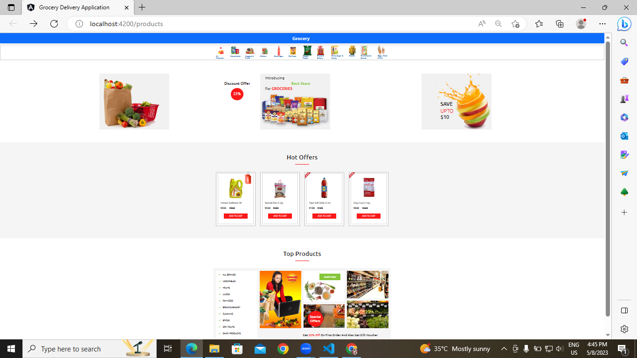
Product category Output

Slide 8
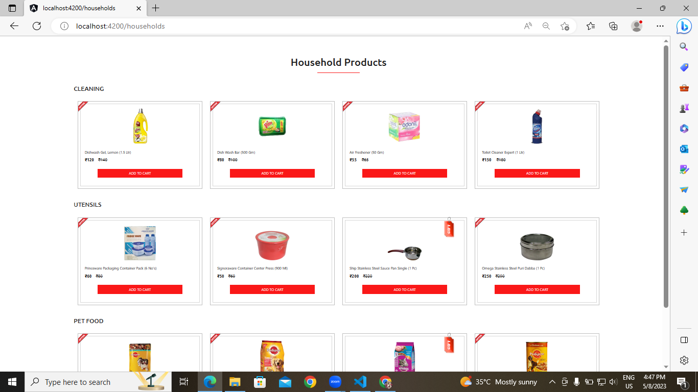
Product category Output

Slide 9
cont’d
Module 2: Order and Payment History
Grocery application system has a major part called Product Order Management which helps the admin to track product ordered and automate the product dispatch, create invoice, decide on shipments and confirm the product after dispatch to be tracked by the client with unique id.
Online payment allows you to pay money via the internet. Buyers will use this type of payment when they purchase goods online or offline.
They can use different types of online payment methods, including debit/credit cards, net banking, and Cash on delivery.

Slide 10
UML DIAGRAM
Cancel Order
Order Cancelled
Order Items
Ordered
Customer
Management
Checkout
Payment
Order and Payment history

Slide 11
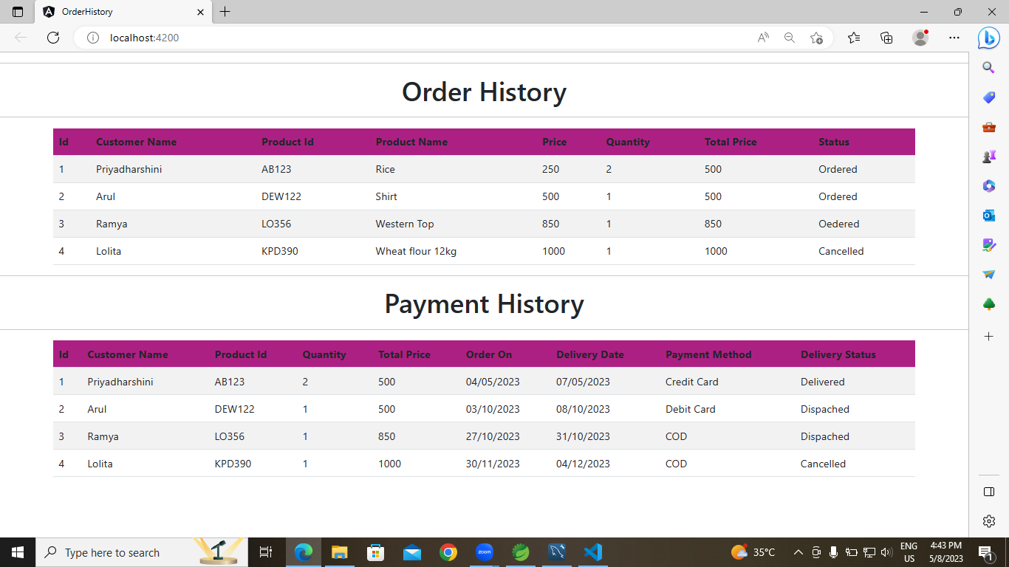
Order and Payment history output
Module 2: Payment Process
Online payment allows you to pay money via the internet. Buyers will use this type of payment when they purchase goods online or offline.
They can use different types of online payment methods, including debit/credit cards, wire transfers, net banking, and digital wallets.

Slide 12
cont’d
Module 3 : ChatBot
Chatbots are conversational tools that perform routine tasks efficiently.
Help your customers find great deals and let them make a purchase right away. Use chatbots to grab customers’ attention, simplify choices, and improve their shopping experience by recommending products they’re interested in.
AIML, or Artificial Intelligence Markup Language, is an XML dialect developers use to create natural language software agents commonly used in chatbots.
Chatbots come under the rule-based chatbots category, however, some level of self-learning feature is feasible.​​​​​​​

Slide 13
UML DIAGRAM
Reply to chat
Open chat
Search results
Ask query
Chatbot
Customer
Reply for query
Search response

Slide 14
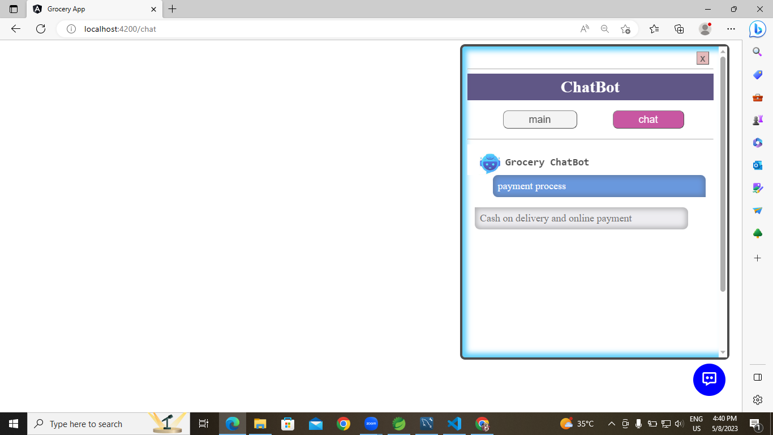
ChatBot Output

Slide 15
CONCULSION
Online shopping is becoming more popular day by day with the increase in the usage of World Wide Web ,Understanding customer’s need for online selling has become challenge for marketers .Specially understanding the consumer’s attitudes towards online shopping , making improvement in the factors that influence consumers to shop online and working on factors that affect consumers to shop online will help marketers to gain the competitive edge over others.

Slide 16
THANK YOU

